Slide 1
CODE LAB-II
Programming Skills Portfolio
Asif Yousaf

Slide 2
Table Of Contents
Chapter 1 - Python Refresher
Chapter 2 - Graphical User Interface
Chapter 3 - Graphical User Interface(Cont.)
Chapter 4 - File Handling and Regular Expressions
Chapter 5 - Object Oriented Programming
Chapter 6 - Python Standard Library Modules

Slide 3
Chapter 1 - Python Refresher
Exercises, Bonus And Further

Slide 4
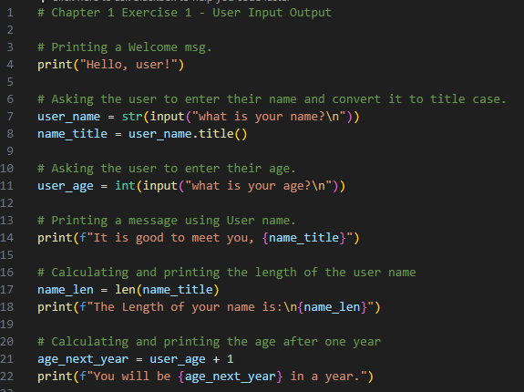
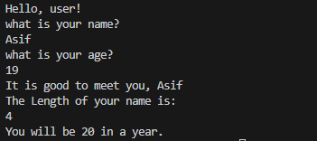
Chapter 1 Ex 1 – User Input Output
This code demonstrates a simple program that interacts with the user, capturing their name and age, and providing personalized messages based on the input. Below, you'll find the Python code, its corresponding output, and additional comments explaining each step.
Code
Output

Slide 5
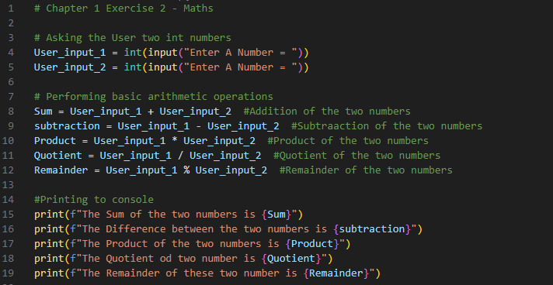
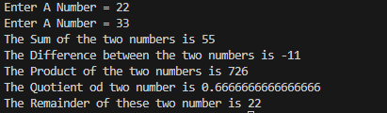
Chapter 1 Ex 2 - Math's
This code demonstrates a straightforward mathematical program that interacts with the user. It prompts the user to input two integer numbers, performs basic arithmetic operations (addition, subtraction, multiplication, division, and modulo), and outputs the results. Below, you'll find the Python code, its corresponding output, and additional comments explaining each step.
Code
Output

Slide 6
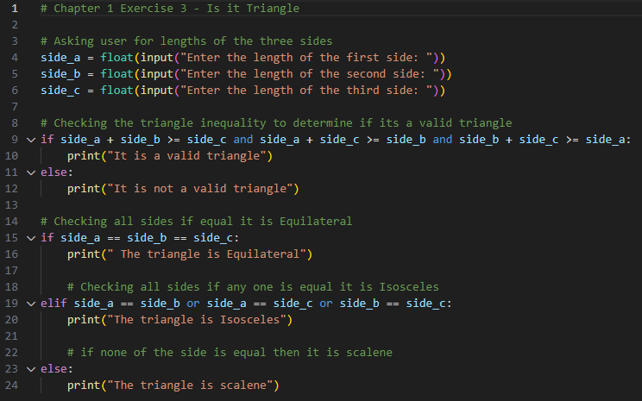

Chapter 1 Ex 3 - Is it Triangle
This code prompts the user to enter the lengths of three sides of a triangle. It then checks the triangle inequality to determine whether the provided side lengths form a valid triangle. If valid, the code proceeds to classify the triangle as Equilateral, Isosceles, or Scalene based on the side lengths. Below, you'll find the Python code, its corresponding output, and additional comments explaining each step.
Code
Output

Slide 7
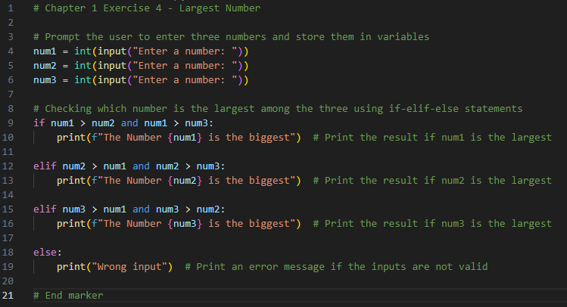

Chapter 1 Ex 4 - Largest Number
This code prompts the user to enter three numbers, compares them, and identifies the largest among them. The Python code, along with its corresponding output and additional comments explaining each step, is presented below:
Code
Output

Slide 8
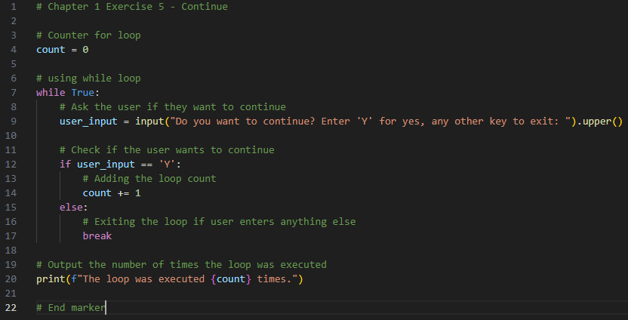
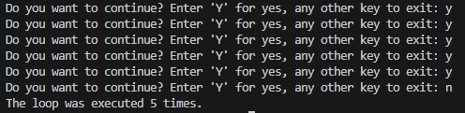
Chapter 1 Ex 5 - Continue
This code presents a simple program utilizing a while loop that interacts with the user, prompting them to continue or exit by entering 'Y' or any other key, respectively. The loop keeps track of how many times it executes, and the final count is printed as output. Below, you'll find the Python code, its corresponding output, and additional comments explaining each step.
Code
Output

Slide 9
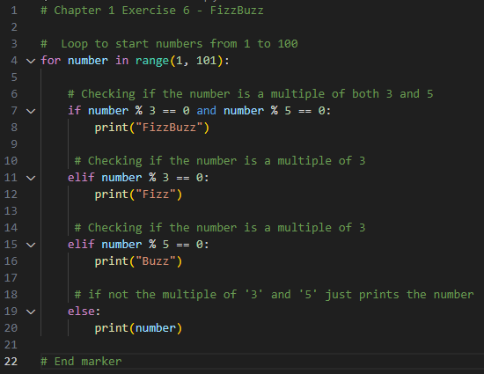




Chapter 1 Ex 6 - Fizz Buzz
This code demonstrates the classic Fizz Buzz problem. It iterates through numbers from 1 to 100 and prints "Fizz" for multiples of 3, "Buzz" for multiples of 5, "Fizz Buzz" for numbers that are multiples of both 3 and 5, and the number itself otherwise. Below, you'll find the Python code, its corresponding output, and additional comments explaining each step.
Code
Output

Slide 10
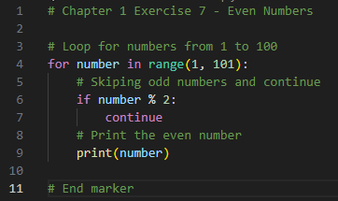


Chapter 1 Ex 7 - Even Numbers
This code generates and prints even numbers between 1 and 100. The program uses a loop to iterate through numbers from 1 to 100. Odd numbers are skipped using the 'continue' statement, and only even numbers are printed. Finally, an end marker indicates the completion of the program.
Code
Output

Slide 11
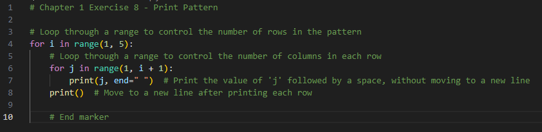

Chapter 1 Ex 8 - Print Pattern
This code presents a simple Python program that generates a numeric pattern. The program utilizes nested loops to control the number of rows and columns, creating a pattern where each row displays sequential numbers. The Python code, its corresponding output, and additional comments detailing each step are provided below.
Code
Output

Slide 12
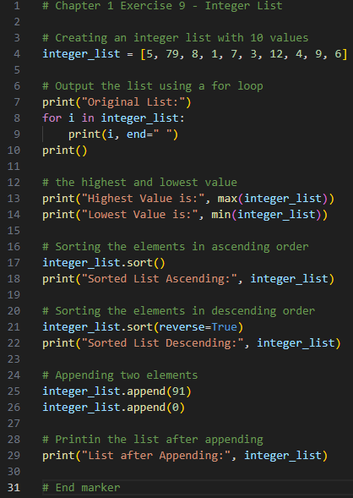

Chapter 1 Ex 9 - Integer List
This code demonstrates a program that works with an integer list. It creates a list, outputs its original form, finds the highest and lowest values, sorts the list in ascending and descending order, appends two elements, and prints the final list.
Code
Output

Slide 13
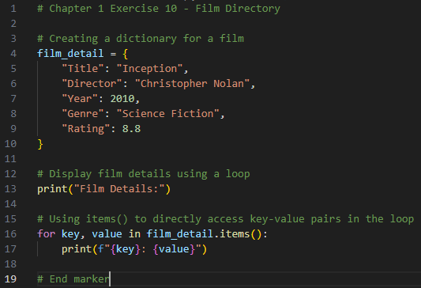
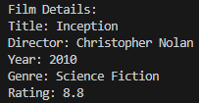
Chapter 1 Ex 10 - Film Dictionary
This code creates a simple film directory using a Python dictionary. The dictionary contains details such as the film title, director, release year, genre, and rating. The program then displays these film details using a loop, showcasing how to iterate through key-value pairs. Below, you'll find the Python code, its corresponding output, and additional comments explaining each step.
Code
Output

Slide 14
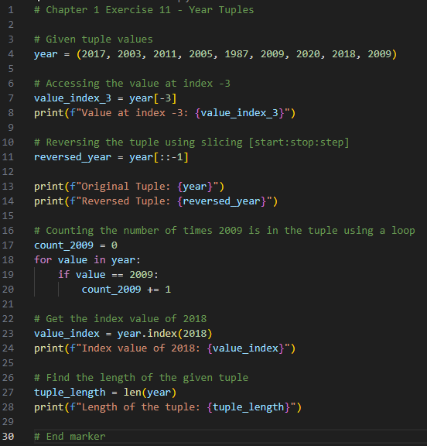

Chapter 1 Ex 11 - Year Tuples
This code explores the manipulation of a tuple containing various years. It demonstrates the retrieval of a specific value, the reversal of the entire tuple, counting occurrences of a particular year, obtaining the index of a specified value, and determining the length of the tuple. Below, you'll find the Python code, its corresponding output, and additional comments explaining each step.
Code
Output

Slide 15
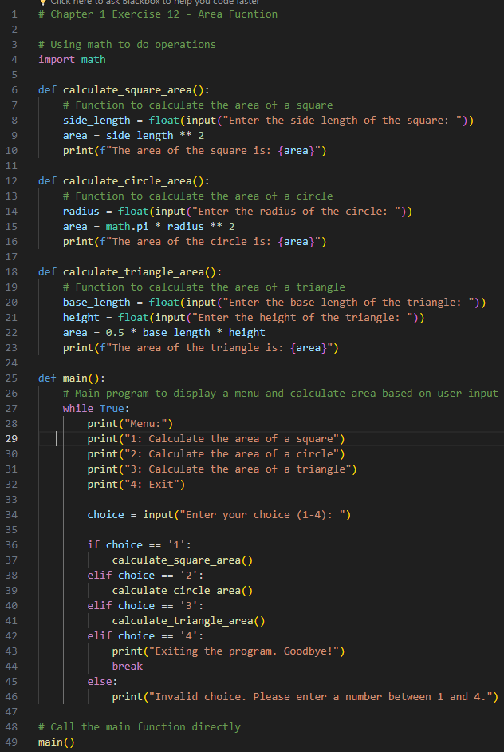
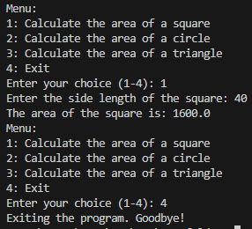
Chapter 1 Ex 12 - Area Function
This code calculates the area of geometric shapes (square, circle, triangle). It uses functions for each shape, a menu for user interaction, and the math module for circle calculations. Below is the Python code, its output, and comments explaining each step.
Code
Output

Slide 16
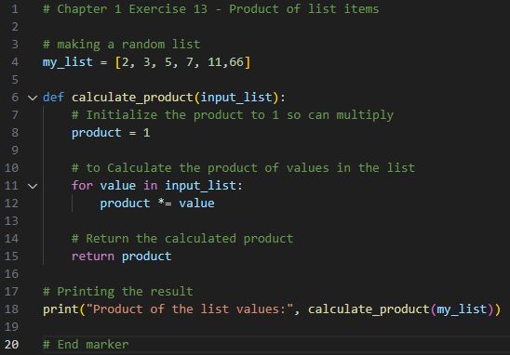
Chapter 1 Ex 13 - Product of list items
This code showcases a simple program that calculates the product of values in a given list. The provided Python code, its corresponding output, and explanatory comments are presented below.
Code
Output

Slide 17
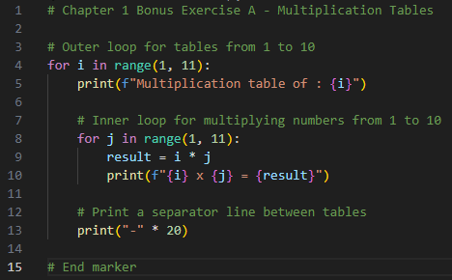
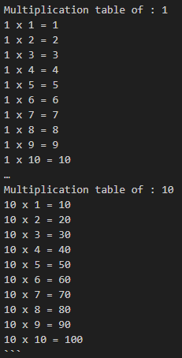
Chapter 1 Bonus Ex A - Multiplication Tables
This code generates multiplication tables for numbers 1 through 10. It utilizes nested loops to iterate through each multiplication table and displays the results. Below, you'll find the Python code, its corresponding output, and additional comments explaining each step.
Code
Output

Slide 18
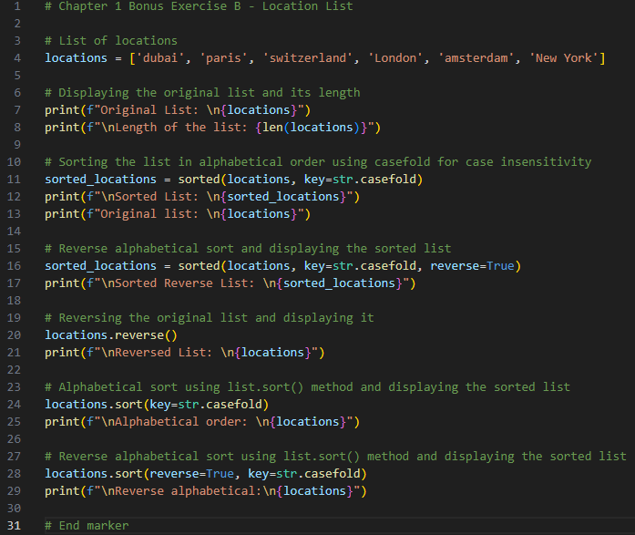
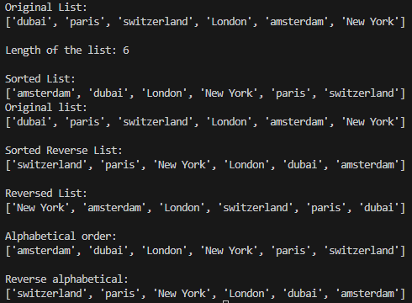
Chapter 1 Bonus Ex B - Locations List
This code demonstrates the manipulation of a list of locations. The original list is displayed, sorted in different ways, reversed, and then sorted in place. Below, you'll find the Python code, its corresponding output, and additional comments explaining each step.
Code
Output

Slide 19
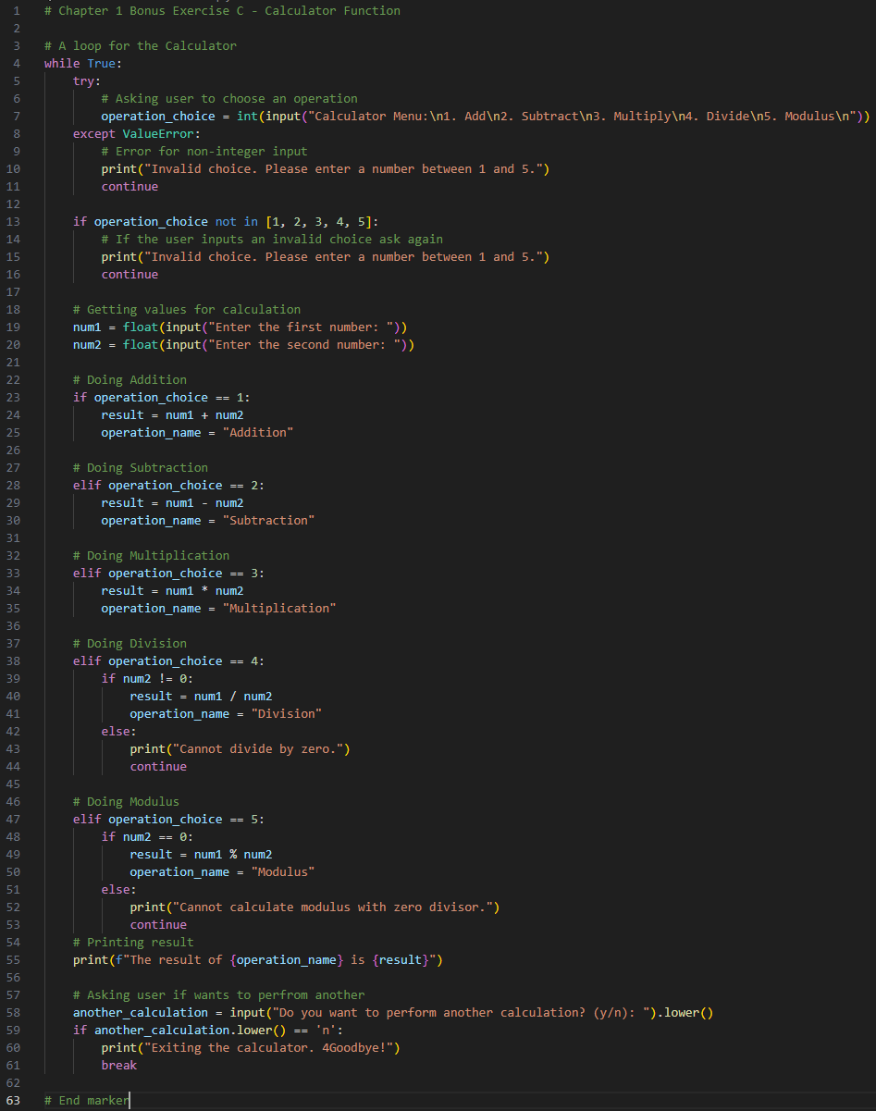
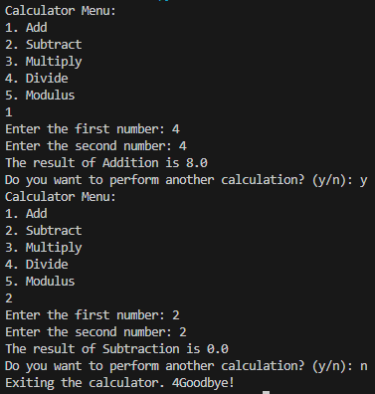
Chapter 1 Bonus Ex C - Calculator Function
This code implements a simple calculator using a loop to allow the user to perform multiple calculations. while True:
Code
Output

Slide 20
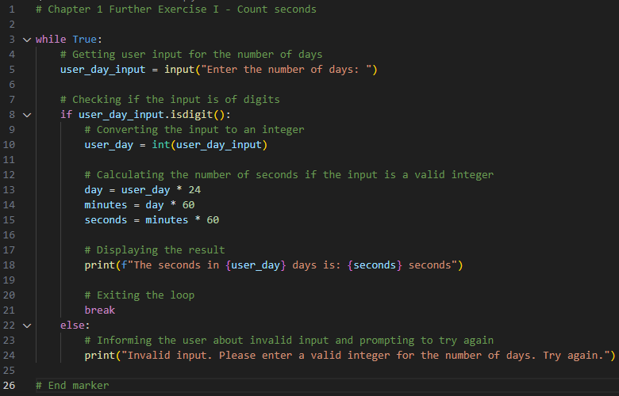

Chapter 1 Further Ex I - Count seconds
This code presents a program that prompts the user to enter the number of days and calculates the corresponding number of seconds. The program ensures valid input by checking if the user's input consists of digits. Below, you'll find the Python code, its corresponding output, and additional comments detailing each step.
Code
Output

Slide 21
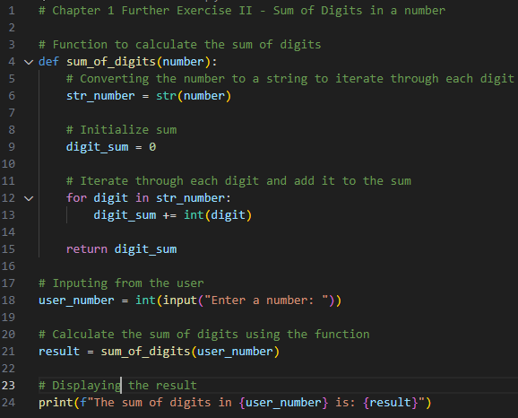

Chapter 1 Further Ex II - Sum of Digits in number
This code presents a program that calculates the sum of digits in a given number. It defines a function, sum of digits, which takes an integer as input, converts it to a string to iterate through each digit, and computes the sum. The user is prompted to input a number, and the program displays the result – the sum of digits in the entered number.
Code
Output

Slide 22
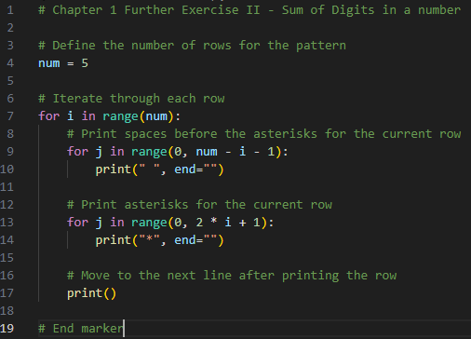

Chapter 1 Further Ex III - Arrows
This code showcases a simple program that generates a pattern using asterisks. The pattern consists of rows where the number of asterisks in each row increases incrementally, creating a visually appealing pyramid-like structure. The number of rows in the pattern is set to 5, but this can be easily adjusted.
Code
Output

Slide 23
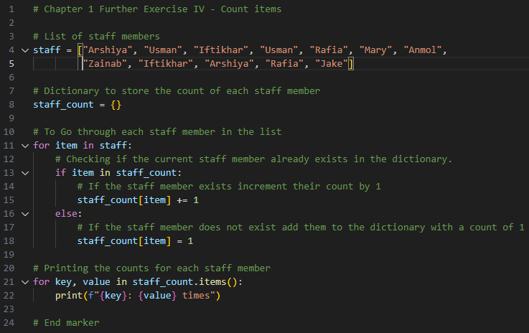
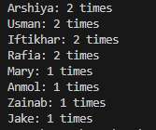
Chapter 1 Further Ex IV - Count items
This code demonstrates a program that counts the occurrences of each staff member in a given list. It uses a dictionary to store the count of each staff member and iterates through the list, updating the counts accordingly. The final output displays the count for each staff member. Below, you'll find the Python code, its corresponding output, and additional comments explaining each step.
Code
Output

Slide 24
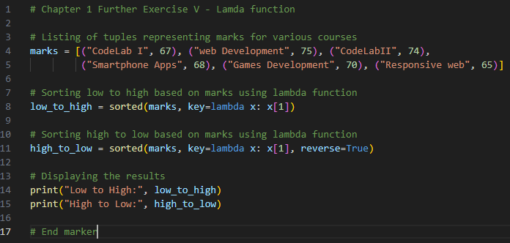
Chapter 1 Further Ex V - Lamda function
This code utilizes lambda functions to sort a list of tuples representing marks for various courses. The tuples consist of the course name and the corresponding mark.
Code
Output

Slide 25
Chapter 2 - Graphical User Interface
Exercises, Bonus And Further

Slide 26
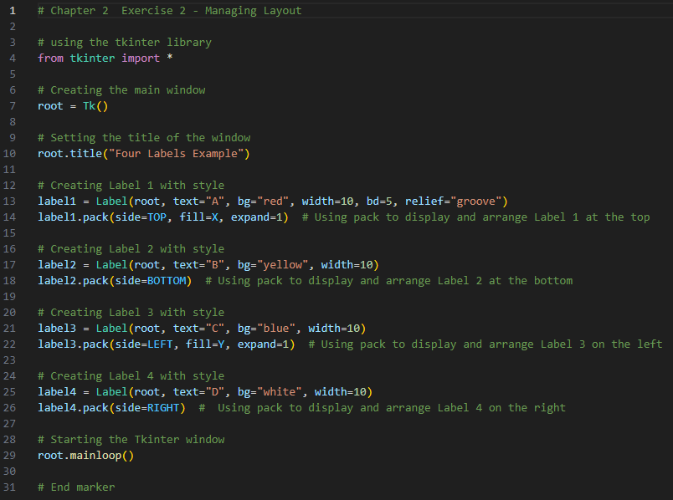
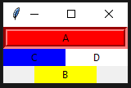
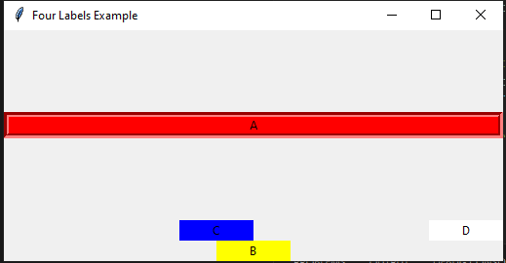
Chapter 2 Ex 2 - Managing Layout
This code showcases the use of the Tkinter library to create a simple GUI with four labels. Each label is styled differently and arranged at different positions within the main window.
Code
Output

Slide 27
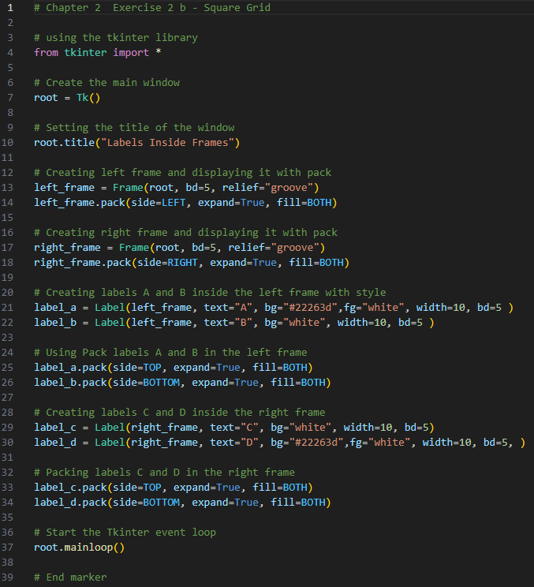

Chapter 2 Ex 2 b - Square Grid
This code showcases a simple graphical user interface (GUI) program using the tkinter library. The program creates a window with two frames, each containing labeled elements.
Code
Output

Slide 28
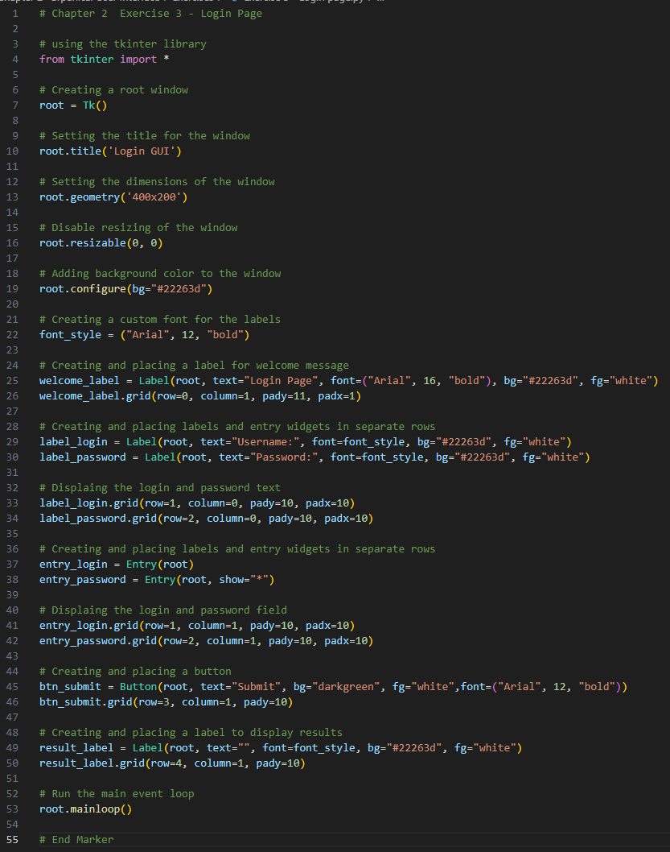
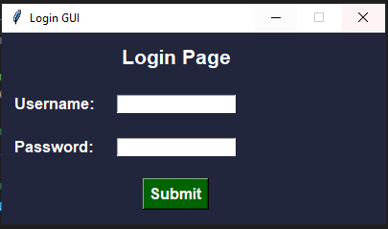
Chapter 2 Ex 3 - Login page
GUI-based login page using tkinter with welcome message, username/password entry, submit button, and result label.
Code
Output

Slide 29
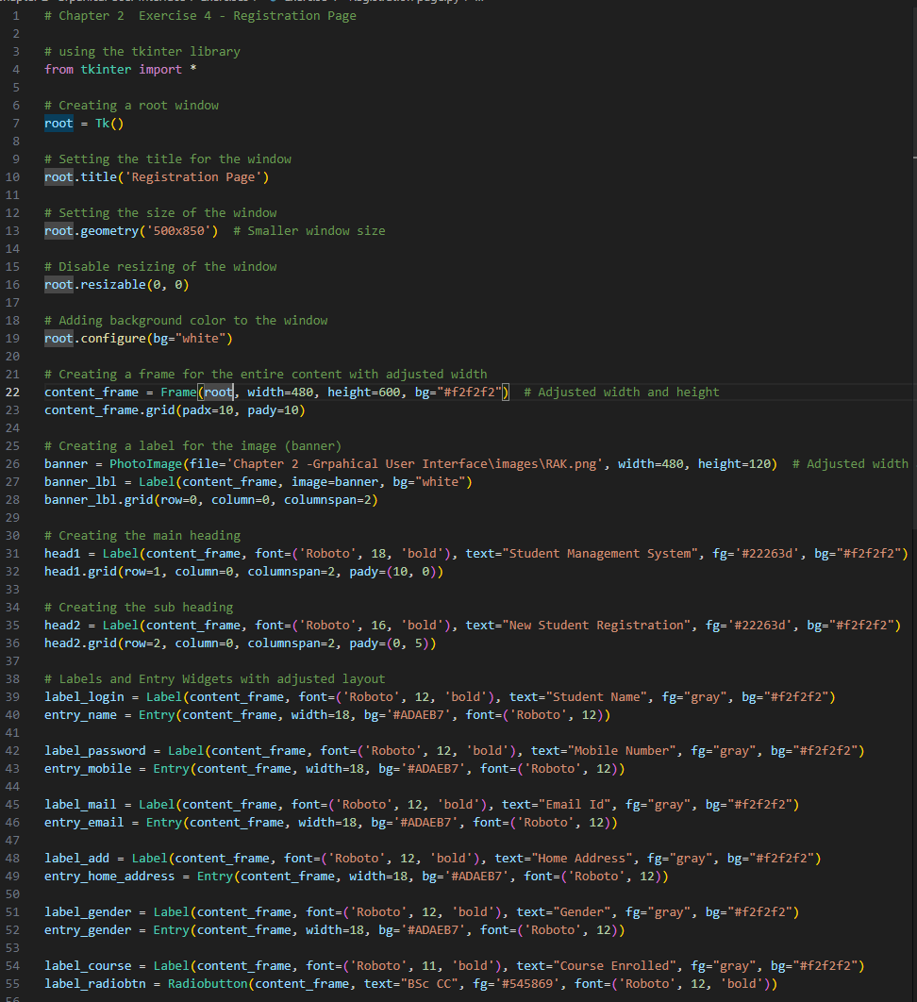
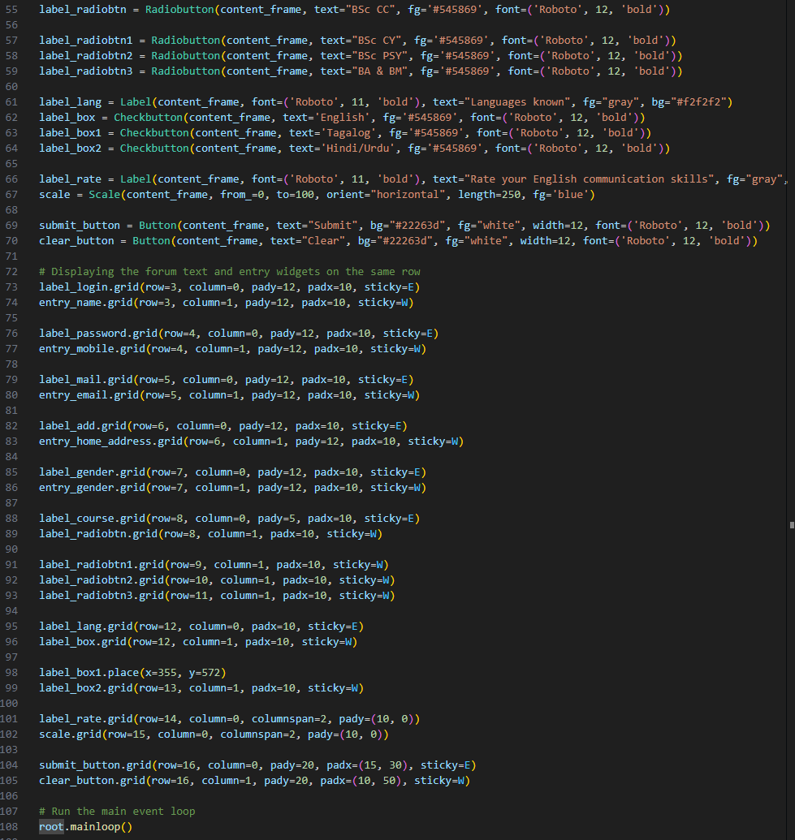
Chapter 2 Ex 4 – Registration page
This Python code utilizes Tkinter to create a student registration GUI. The form captures essential details: name, mobile number, email, address, gender, enrolled course, languages, and English communication skills. The breakdown includes code and output
Code

Slide 30
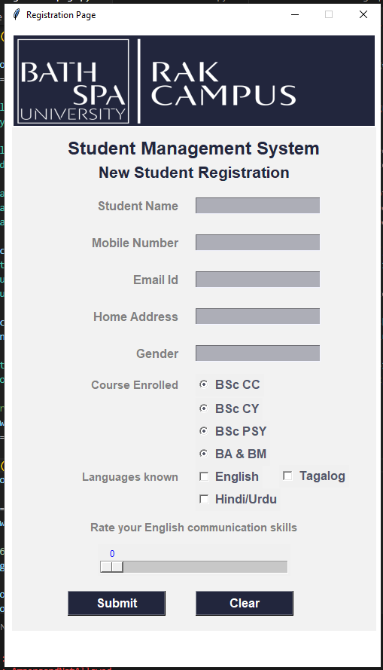
Chapter 2 Ex 4 – Registration page
Output

